Slide 1
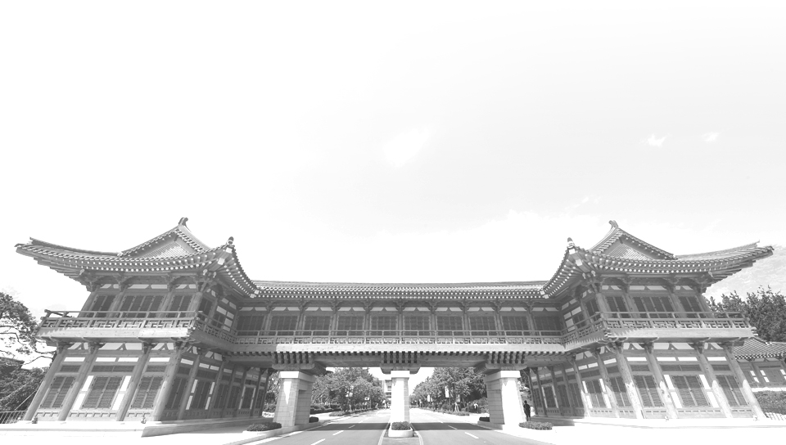


Cloud Computing
JEONBUK NATIONAL UNIVERSITY

Slide 2
Contents
What is Cloud Computing?
Study Roadmap

Slide 3
1
What is
Cloud Computing?
JEONBUK NATIONAL UNIVERSITY

Slide 4
•Cloud computing is the delivery of hosting services that are provided to a client over the Internet.
•Enable large-scale services without up-front investment.

Slide 5
•NIST Definition of Cloud Computing
Cloud computing is a model for enabling convenient, on-demand network access to a shared pool of configurable computing resources (e.g., networks, servers, storage, applications, and services) that can be rapidly provisioned and released with minimal management effort or service provider interaction.

Slide 6
•Cloud computing is Utility Computing
Cloud services are controlled and monitored by the cloud provider through a pay-per-use business model.

Slide 7
•An ideal cloud computing platform
efficient in its use of resources
elastic
self-managing
highly available and accessible

Slide 8
•Resource efficiency
computing and network resources are pooled to provide services to multiple users. Resource allocation is dynamically adapted according to user demand.
•Elasticity
computing resources can be rapidly and elastically provisioned to scale up, and released to scale down based on consumer’s demand.

Slide 9
•Self-managing services
a consumer can provision cloud services, such as web applications, server time, processing, storage and network as needed and automatically without requiring human interaction with each service’s provider
•Accessible and highly available
cloud resources are available over the network anytime and anywhere and are accessed through standard mechanisms that promote use by different types of platform (e.g., mobile phones, laptops, and PDAs).

Slide 10
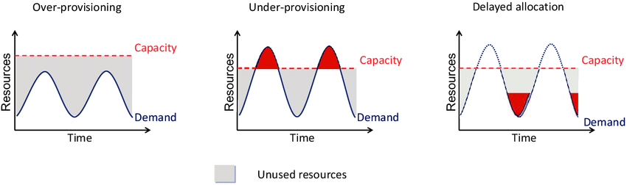
•over-provisioning, under-provisioning

Slide 11
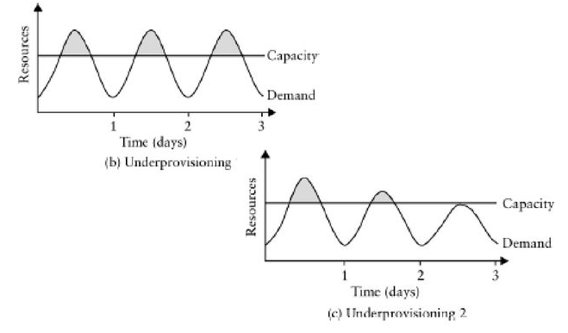
•In traditional computing model, two common problems
Underestimate system utilization which result in under provision
Loss Revenue
Loss Users

Slide 12
• Overestimate system utilization which results in low utilization
•How do we solve this problem? - Dynamically provision resources

Slide 13
•There are four primary cloud deployment models
- Public Cloud
- Private Cloud
- Community Cloud
- Hybrid Cloud

Slide 14
•Public clouds are owned by cloud service providers who charge for the use of cloud resources.
•AWS/EC2 (Amazon)
•Azure (Microsoft)
•Google Cloud Platform.
•Rackspace.

Slide 15
•Private clouds are infrastructure belongs to and is operated by only one organization.
•Eucalyptus Systems
•OpenNebula
•Openstack

Slide 16
•Community cloud
The cloud infrastructure is shared by several organizations and supports a specific community that has shared concerns
(e.g., mission, security requirements, policy, and compliance considerations).
•Hybrid cloud
The cloud infrastructure is a composition of two or more clouds (private, community, or public) that remain unique entities but are bound together by standardized or proprietary technology that enables data and application portability.

Slide 17
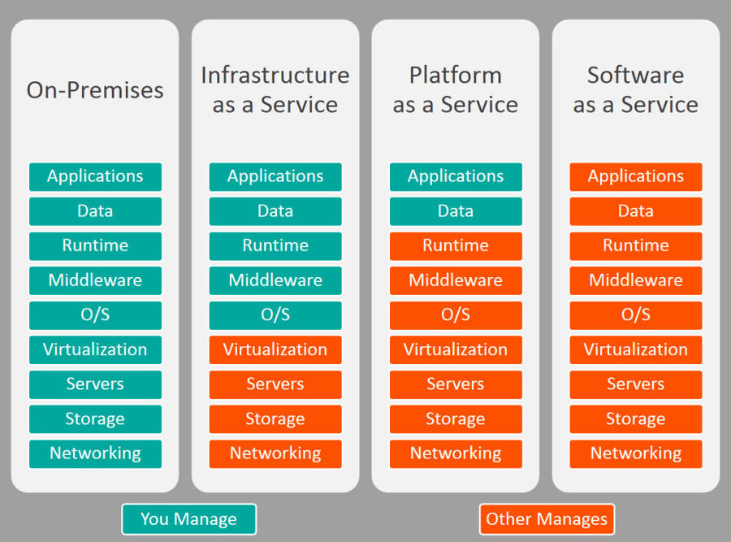
•Infrastructure as a Service (IaaS)
•Platform as a Service (PaaS)
•Software as a Service (SaaS)

Slide 18
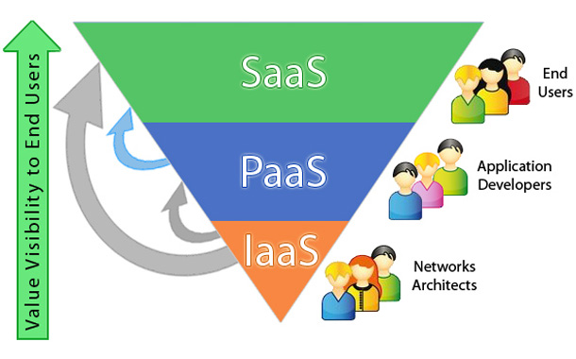

Slide 19
•IaaS provides virtual machines, but it cannot provide elastic computing by itself, where services scale up and down to meet user demand.
- Dynamic provisioning
•Existing IaaS do not provide support for the sharing middleware platforms among different VMs
- Multi-tenancy

Slide 20
•Multi-tenancy is where a single instance of the software runs on a server, serving multiple clients.
Think multiple users in a MySQL database
Java 9 should support multi-tenancy (many java programs running in the same JVM)
•The software should be able to provide a single service to all customers by setting configurations
- More efficient use of server resources

Slide 21
•Platform as a Service (PaaS) is a computing platform that abstracts the infrastructure, OS, and middleware to drive developer productivity.
•PaaS leverages dynamic provisioning
•PaaS leverages multi-tenancy

Slide 22
•A closed PaaS provides a fixed set of services you can use. You cannot install your own services.
•An open PaaS provides support for you to develop your own automated service deployments.

Slide 23
•Software as a Service - SaaS
Run applications on a provider’s on a cloud infrastructure.
Applications are accessible from various client devices through a thin client interface such as a web browser.
User is oblivious to the underlying cloud infrastructure
•Examples - Dropbox
Google Apps (e.g., Gmail, Google Docs, Google sites,..)
SalesForce.com

Slide 24
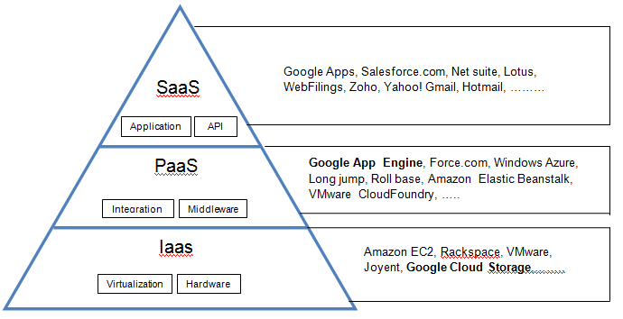

Slide 25
•Cloud computing has enabled an explosion in largescale computing services and applications.
•Clouds provide services at three main levels: IaaS, PaaS, SaaS.
•New programming models enable easier development of large-scale applications.

Slide 26
2
Study Roadmap
JEONBUK NATIONAL UNIVERSITY

Slide 27
Linux
AWS
Network

Slide 28
감사합니다
JEONBUK NATIONAL UNIVERSITY

